Slide 1
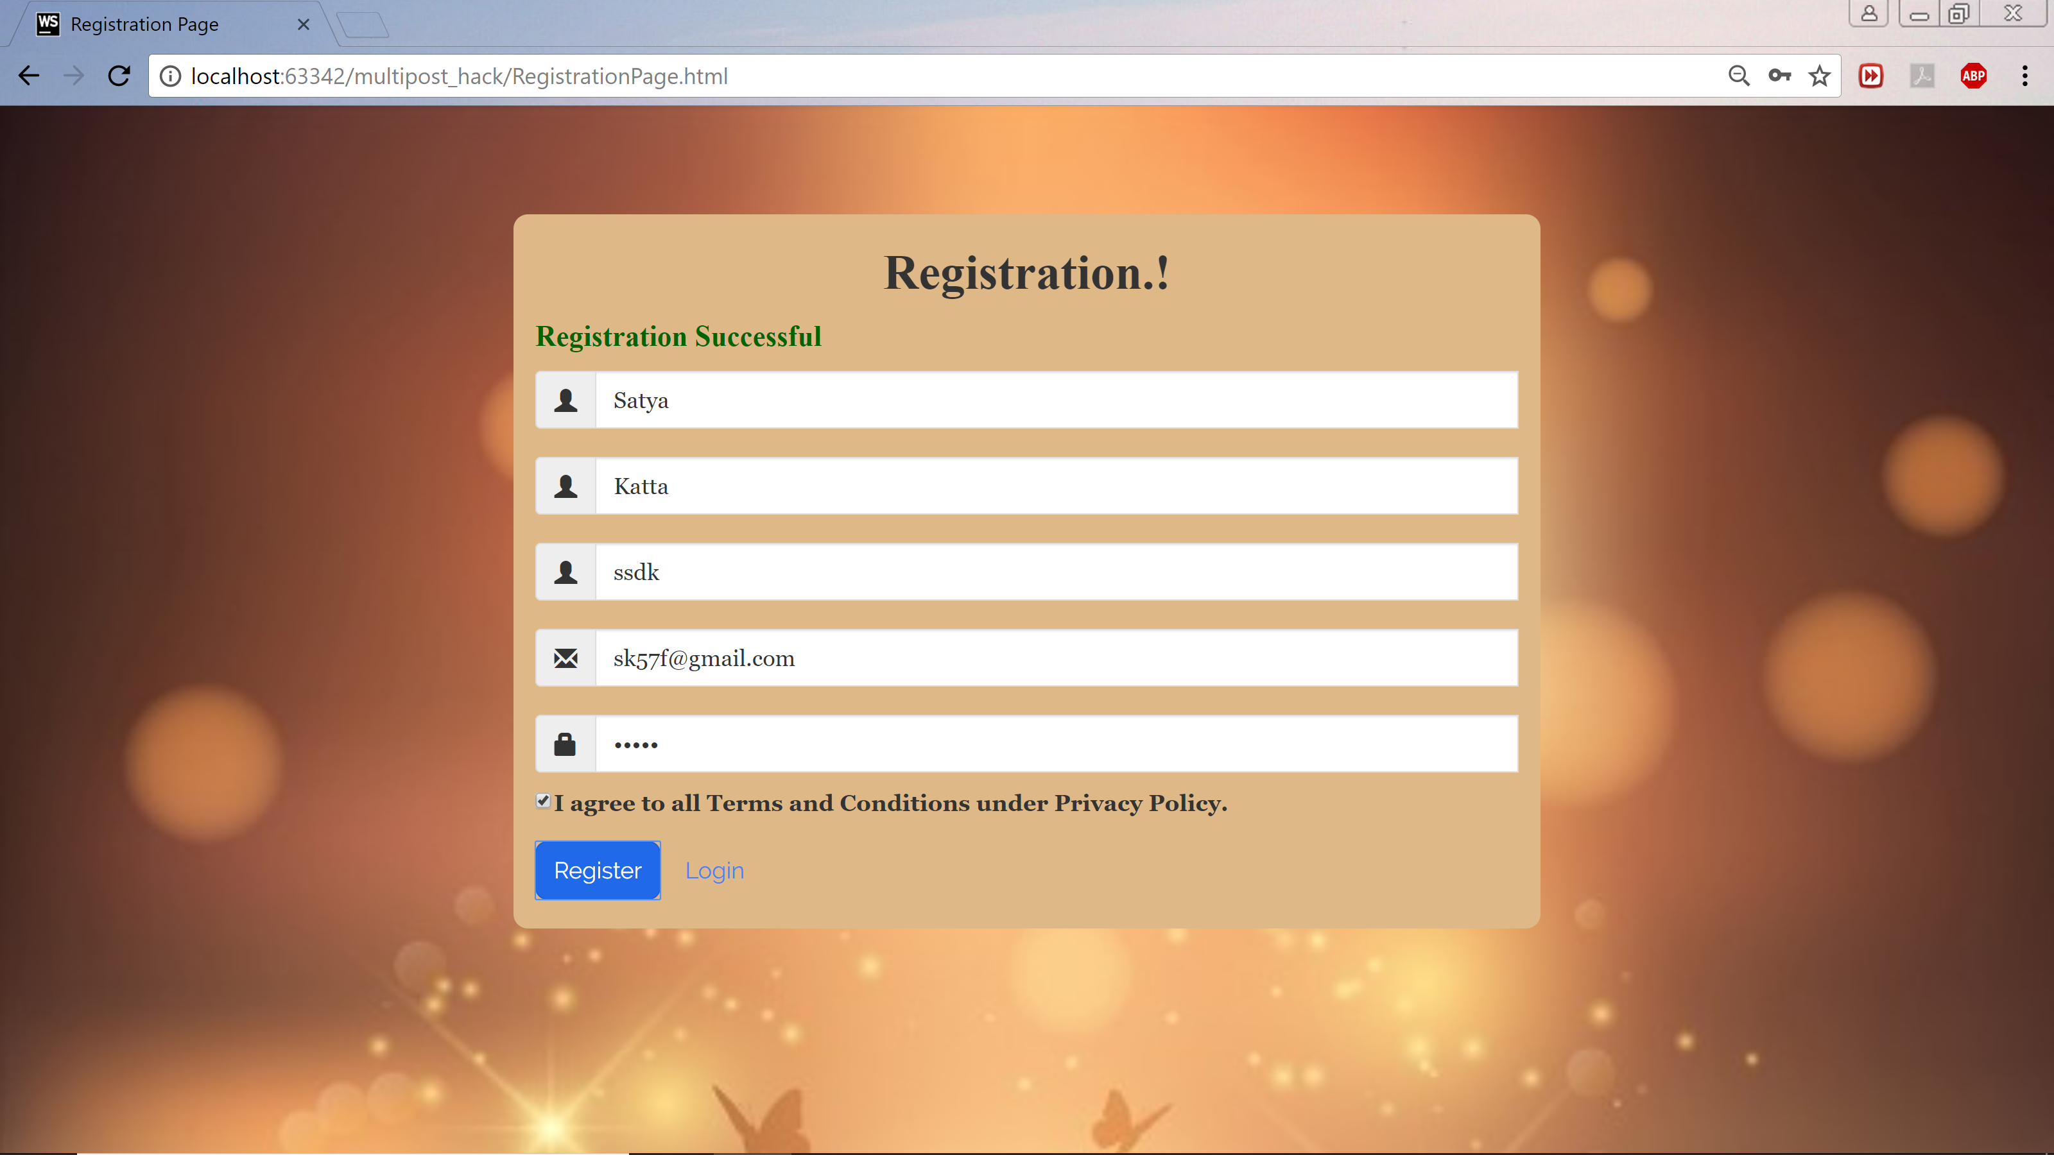
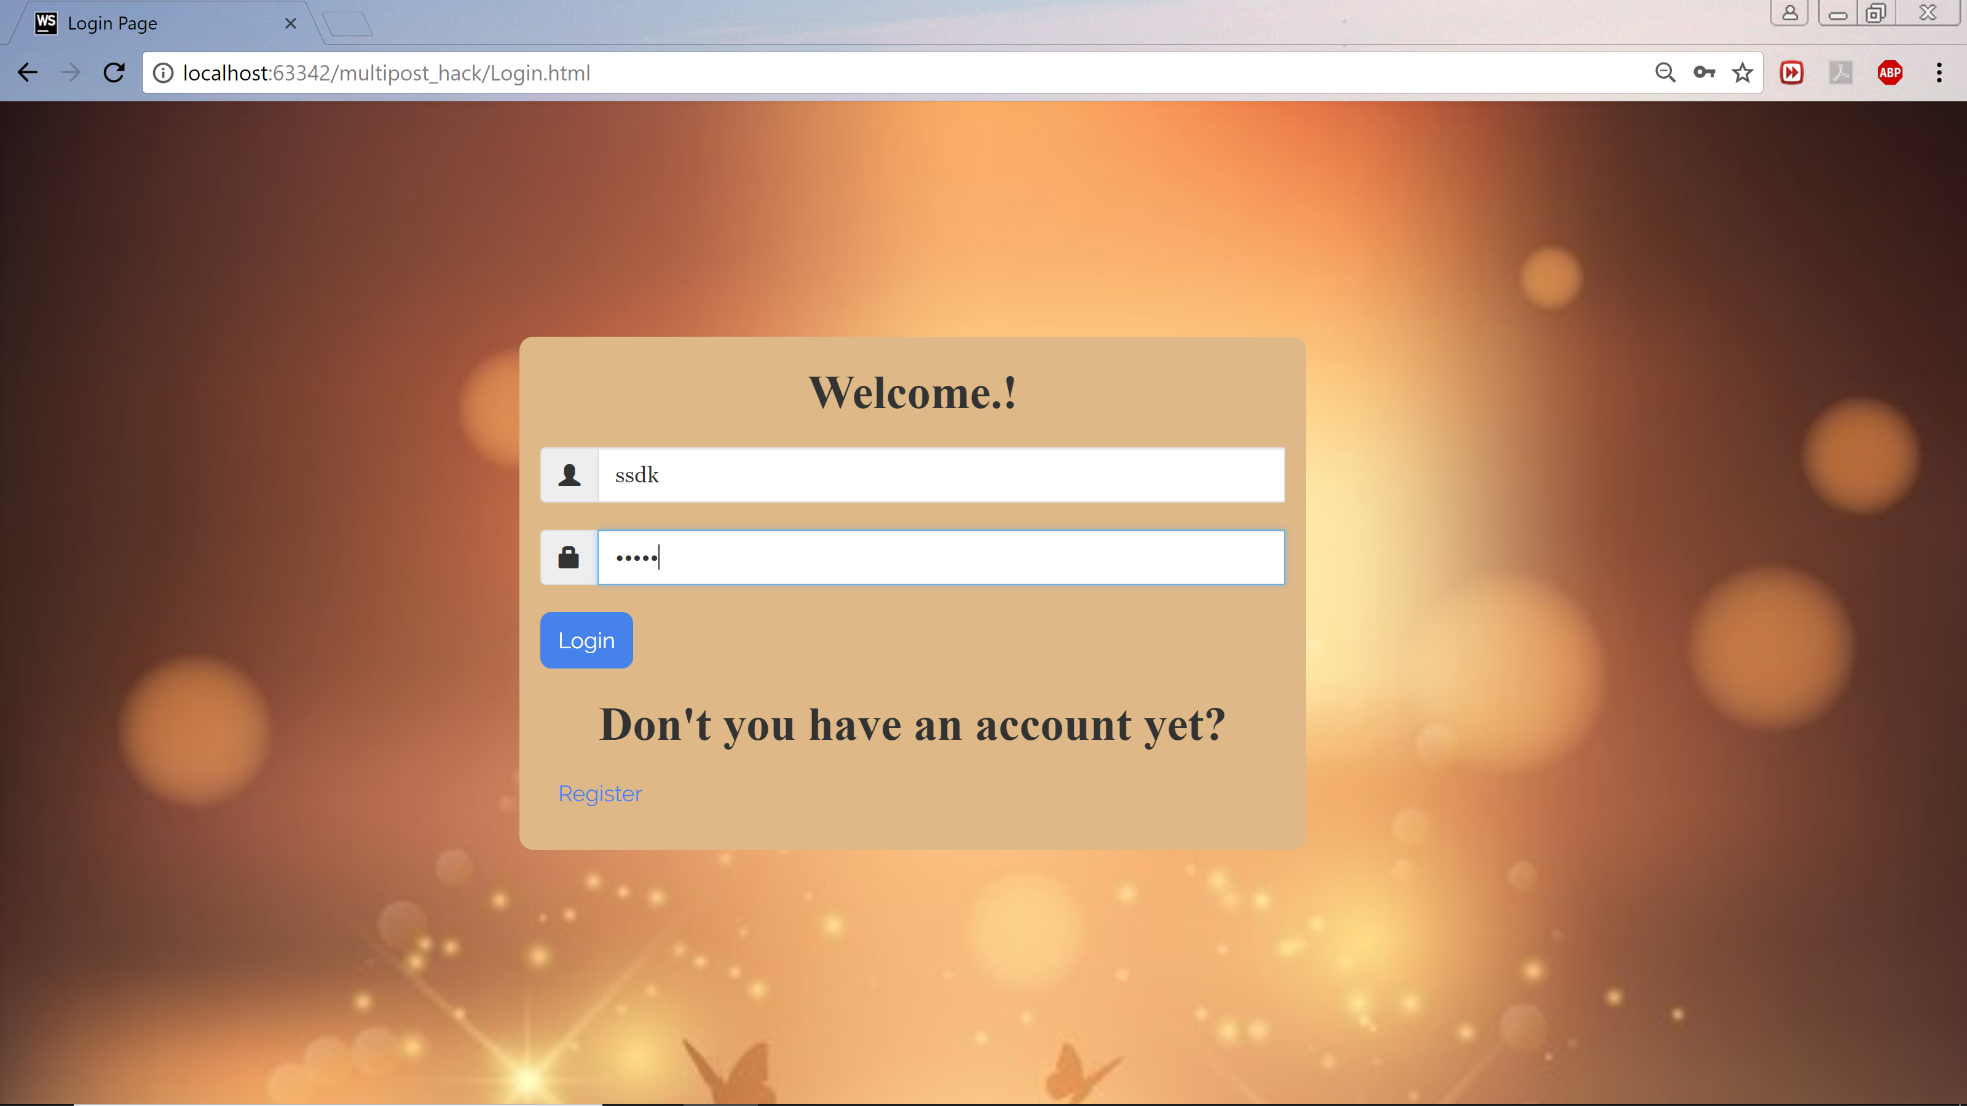
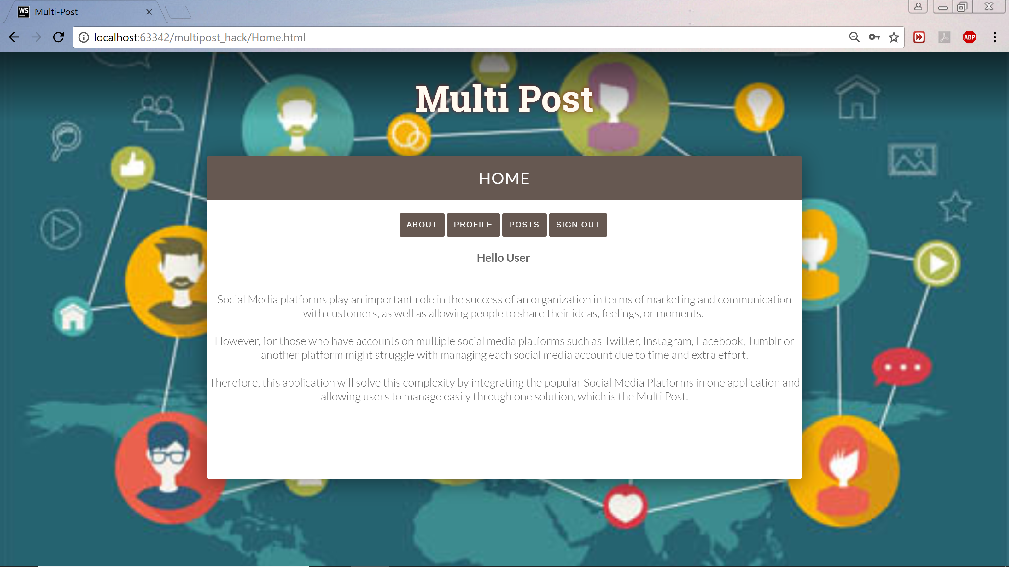
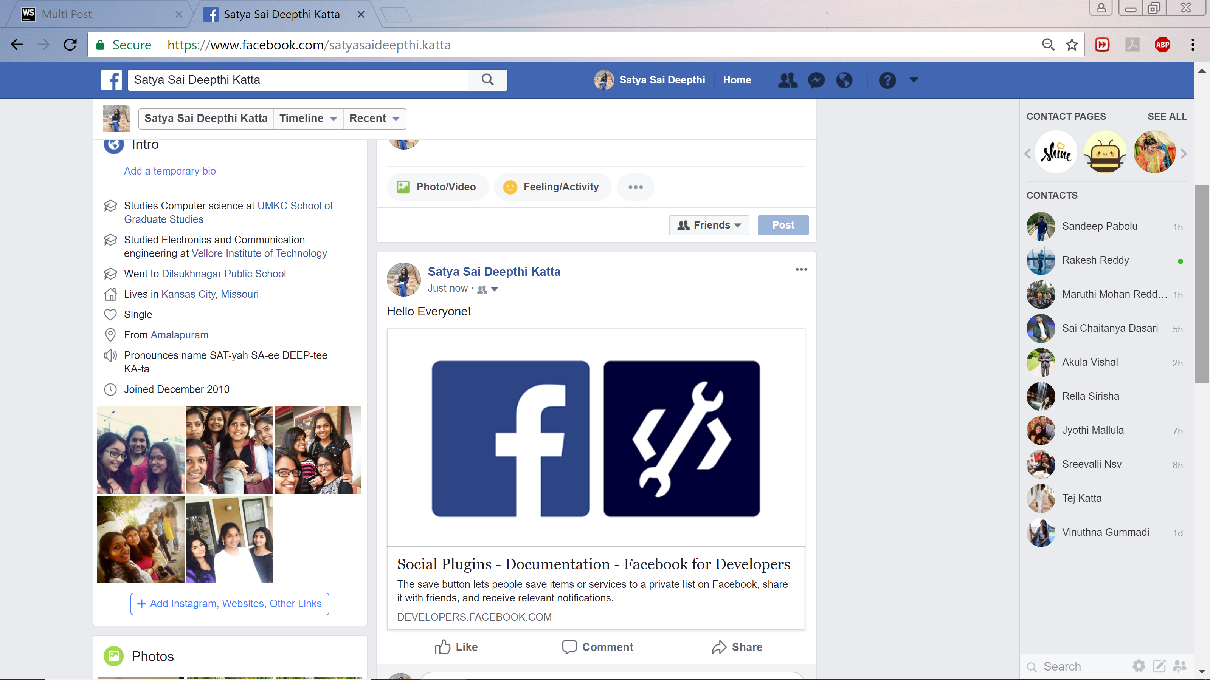
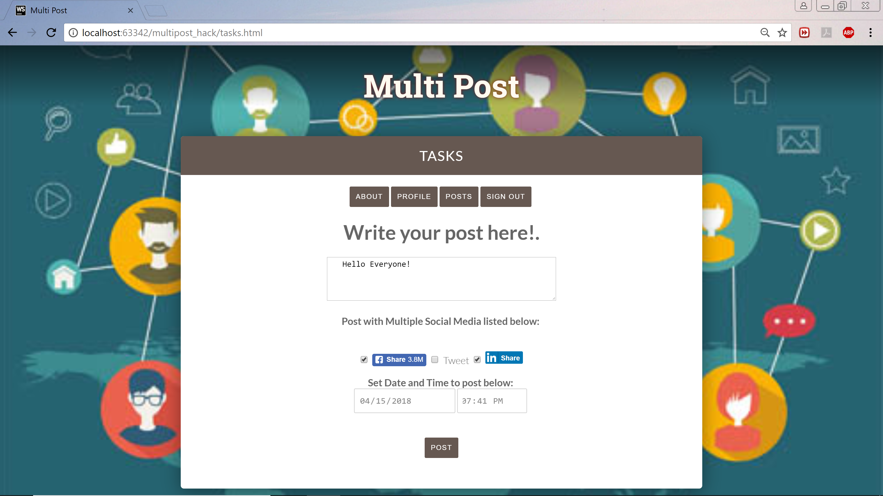
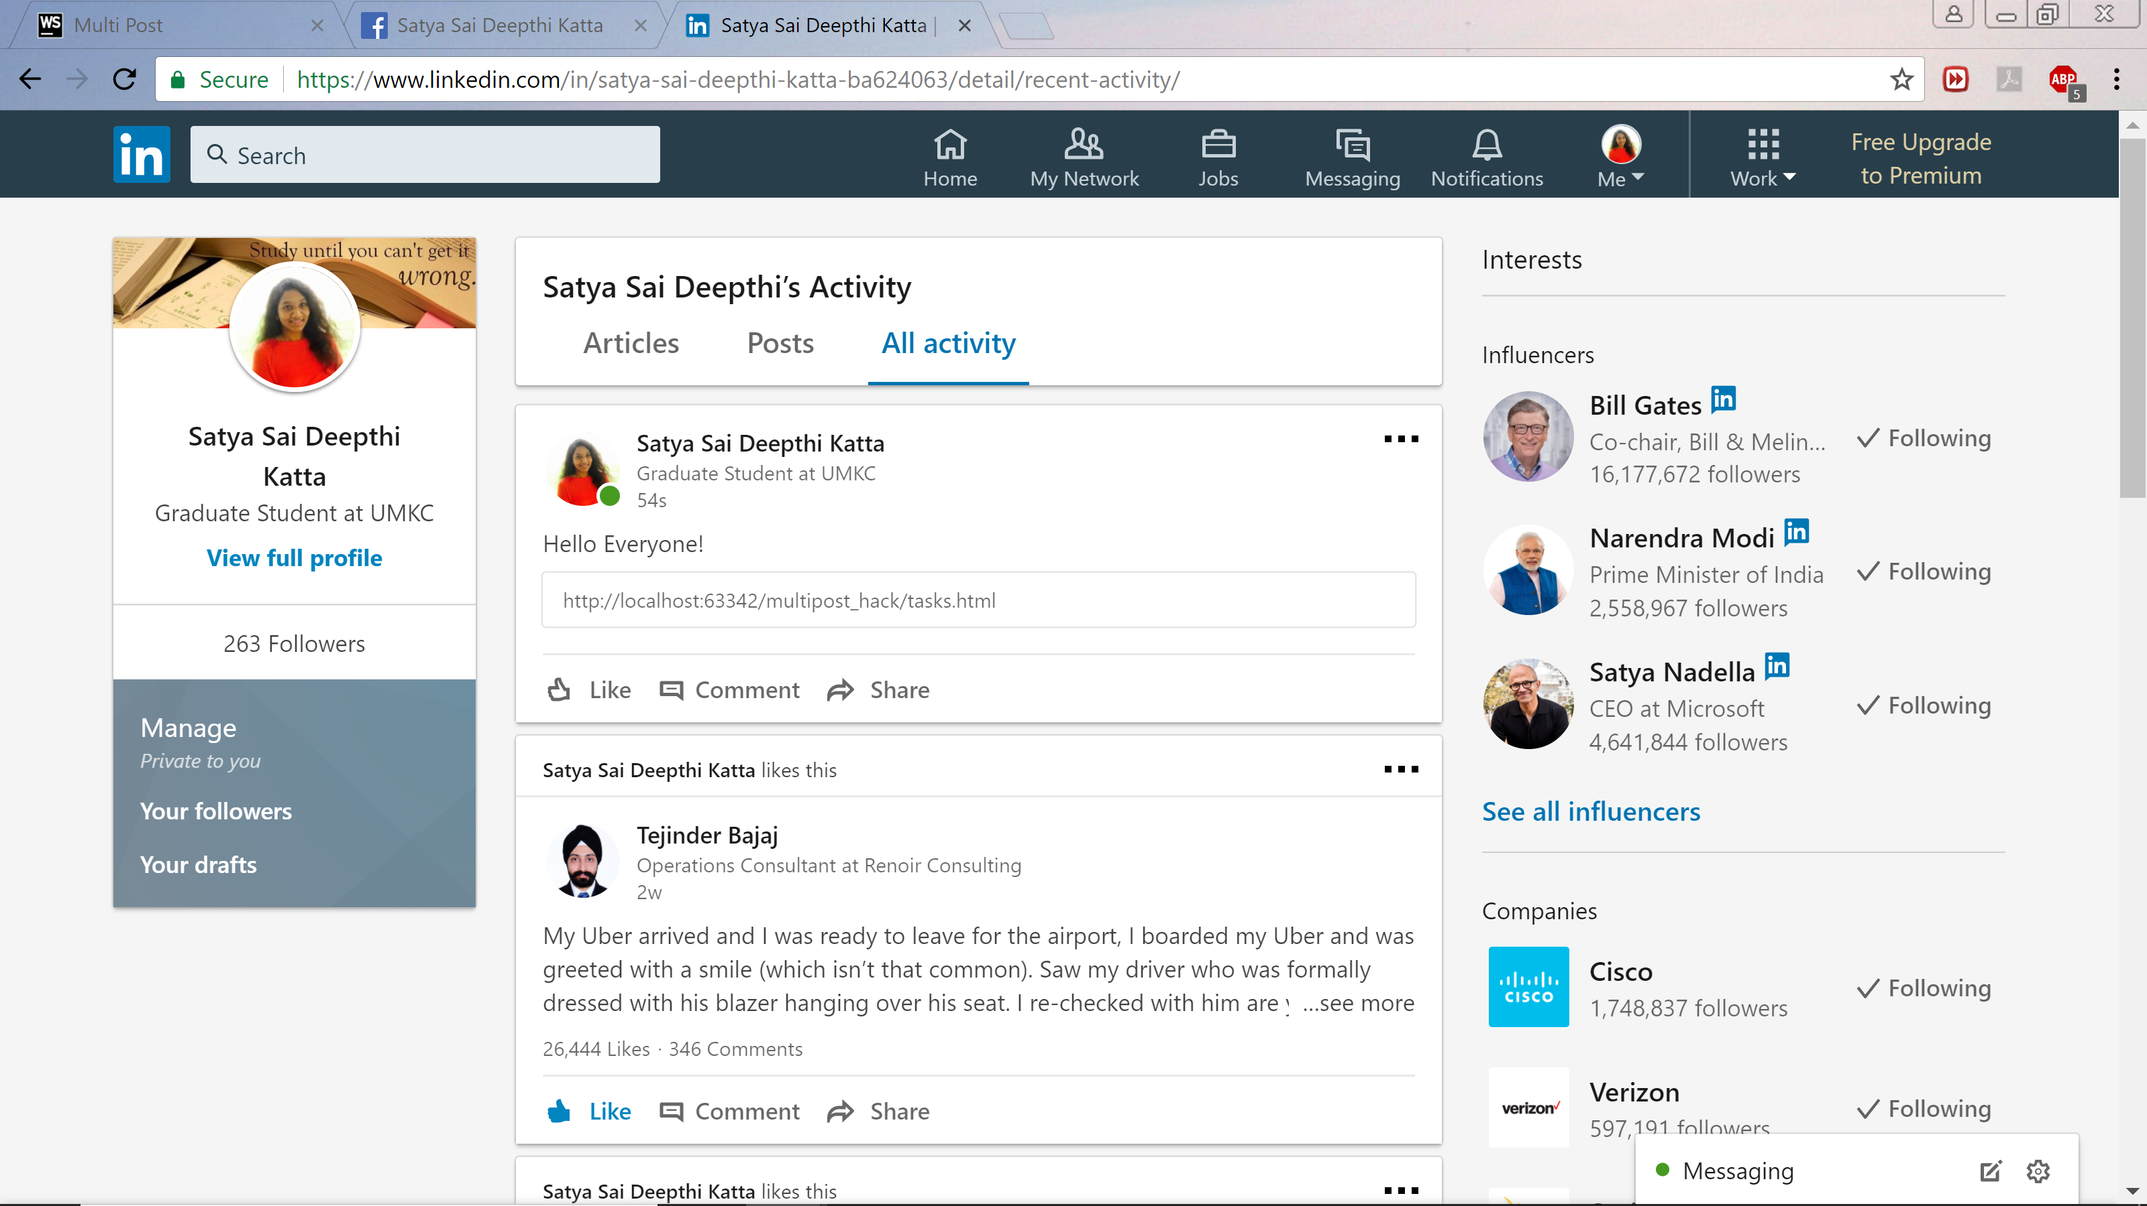
MULTI – POST : A web application to solve the complexity of integrating popular Social Media Platforms on a single platform allowing users to manage and schedule posts easily by reducing their time and extra effort.
Create A New Account!
Log in to User Account!
Application Requirements:
1
2
Facebook API.
Linkedin API.
Twitter API
Software Development
IDE: WebStorm
Database: MongoDB API
Languages: HTML, CSS, JavaScript,PHP
OS: Mac, Windows 10
Create a Post; Select Social Media Platforms; Set Time and Date to Post!
View Social Media Timelines!
3
4
Features
Unique User ID
Multi Browser Compatible
Time and Date Scheduling
User Preferred Social Media Selection
Customized Post Visibility
Contributors
Satya Sai Deepthi Katta | Rakesh Reddy Pallepati
Sandeep Pabolu | Kamal Tej Veerapaneni

